Slide 1
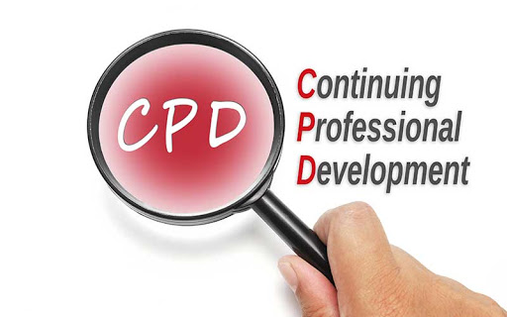
LO3-Week 8-
Basic structure of An organization & an organigram design for a learning plan

Slide 2

Aim;
L03-Negotiate and plan learning, continuing professional development needs.
Learning outcomes
At the end of this lesson students will be able to;
Produce an organigram for a learning plan design to meet the need of individuals
Describe the Basic structure of an organisation

Slide 3

LO1 Activity -10 mins
Class Discussion
What is An Organisation ?

Slide 4
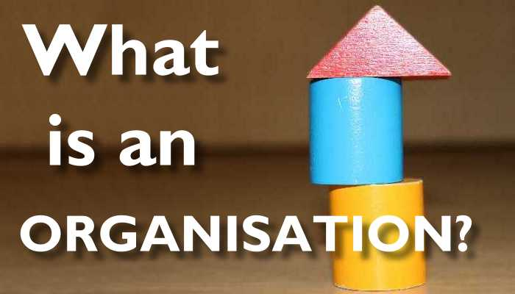

Slide 5
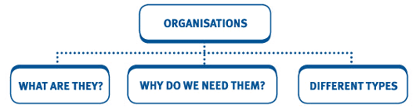

Slide 6
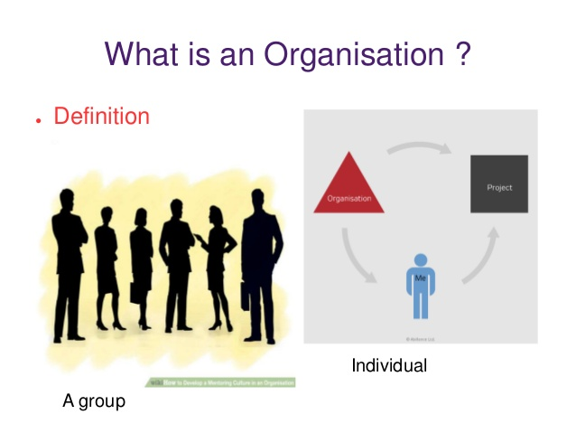
Organisation
Ever since the dawn of civilization, people have always formed organisations to combine their efforts for the accomplishments of their common goals.
For example, the Emperors of China used organisations a thousand years ago to construct great irrigation systems.
The first Pope created a universal church to serve a world religion.
The greatest example is the construction of great pyramids by the early Egyptians.

Slide 7
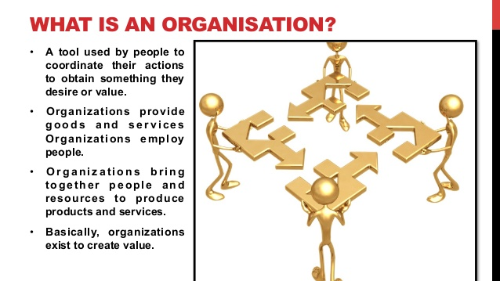

Slide 8

Concept of Organisation:
It is very difficult to define the term organisation precisely because the use of the term organisation is not standardized. It is not static.
It is dynamic and ever changing as per the needs of society, its members, business objectives and environmental changes.
Organisation has been defined in different ways by different theorists, because different theorists have emphasized different characteristics of organisation.

Slide 9

An organization, or organisation, is an entity – such as a company, an institution, or an association – comprising one or more people and having a particular purpose.
“Organisations are defined as collect ivities that have been established for the pursuit of relatively specific objectives on a more or less continuous basis.
Organisations have more or less fixed boundaries, a normative order, authority rank, a communication system and an incentive system which enables various types of participants to work together in the pursuit of common goals.”

Slide 10

An organization is a group of people who work together, like a neighborhood association, a charity, a union, or a corporation. Organization is also the act of forming or establishing something (like an organization). It can also refer to a system of arrangement or order, or a structure for classifying things.

Slide 11
key areas of development will help you acquire valuable skills
As you analyse your professional behaviour, consider if any of these
Goal-setting.
Communication.
Collaboration. ... Enhance communication skills.
Listen to your mentor.
Upgrade your skills.
Listening.
Conflict resolution.
Adaptability.
Organization.
Accepting constructive feedback.
Communication skills (listening, speaking and writing)
Analytical and research skills.
Flexibility/adaptability.
Interpersonal abilities.
Ability to make decisions and solve problems.
Ability to plan, organise and prioritise work.
Ability to wear multiple hats.
Leadership/management skills.
Complete a professional certificate or degree.
Work well on a team.
I sometimes lack confidence.

Slide 12
What is an Organisation in health and social care?
The Health and Social Care sector consists of any organisation which provides healthcare support to people, for example hospitals, dentists, and specialist support like physiotherapy, and social care support, for example, nursing homes, foster caring, and nurseries.
The Health and Social Care sector consists of any organisation which provides healthcare support to people, for example hospitals, dentists, and specialist support like physiotherapy, and social care support, for example, nursing homes, foster caring, and nurseries. In short, it includes any organisation or service which helps people live more independent, healthier lives.

Slide 13

What is an organogram?

Slide 14
What's an organogram?
An organogram is a graphical representation of an organisation’s structure.
It’s used to show hierarchical relationships between managers and the people who report to them, as well as departments.
An organogram is a useful tool for organisations to both visualise reporting relationships and communicate employees’ names, skills, and contact information.
The term "organogram" is used most often in the UK and is synonymous with "org chart.“

Slide 15
LO1-Activity-Individual Research -10mins
Now lets look at …An Organizational Structure
Conduct an individual research ;
What is organisational structure ?

Slide 16
An organizational structure is a system that outlines how certain activities are directed in order to achieve the goals of an organization. These activities can include rules, roles, and responsibilities.
The organizational structure also determines how information flows between levels within the company.
For example, in a centralized structure, decisions flow from the top down, while in a decentralized structure, decision-making power is distributed among various levels of the organization.
Having an organizational structure in place allows companies to remain efficient and focused.
Now lets look at …What Is an Organizational Structure?

Slide 17
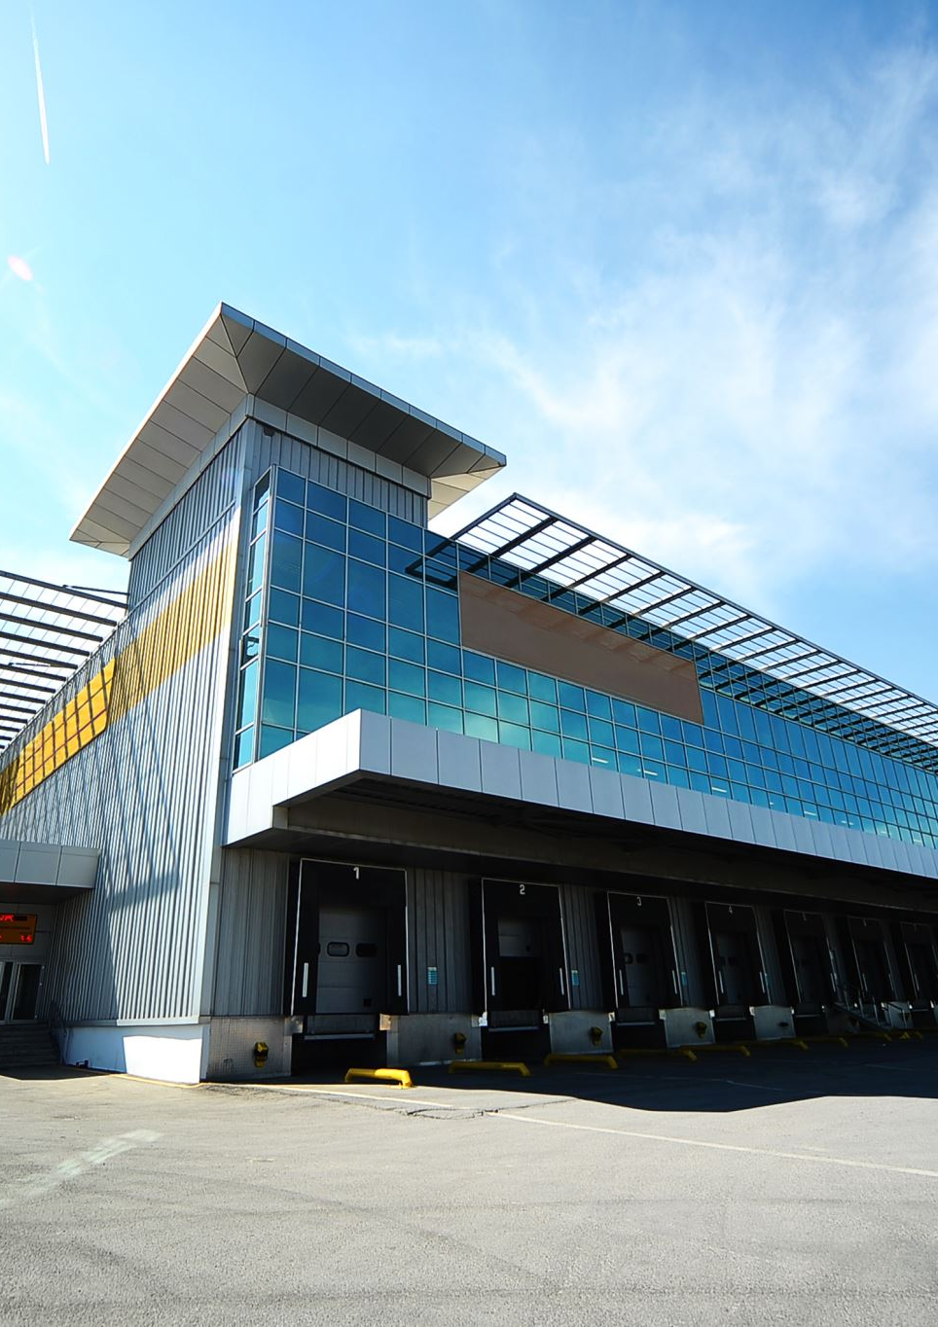
Businesses of all shapes and sizes use organizational structures heavily. They define a specific hierarchy within an organization.
A successful organizational structure defines each employee's job and how it fits within the overall system.
Put simply, the organizational structure lays out who does what so the company can meet its objectives.
This structuring provides a company with a visual representation of how it is shaped and how it can best move forward in achieving its goals.
Organizational structures are normally illustrated in some sort of chart or diagram like a pyramid, where the most powerful members of the organization sit at the top, while those with the least amount of power are at the bottom.

Slide 18

Models of organizational structure
Hierarchical org structure
Functional org structure
Horizontal or flat org structure
Divisional org structures (market-based, product-based, geographic)
Matrix org structure
Team-based org structure
Network org structure.

Slide 19

Cont…
Not having a formal structure in place may prove difficult for certain organizations. For instance, employees may have difficulty knowing to whom they should report.
That can lead to uncertainty as to who is responsible for what in the organization.
Having a structure in place can help with efficiency and provide clarity for everyone at every level.
That also means each and every department can be more productive, as they are likely to be more focused on energy and time.

Slide 20
Benefits of Organizational Structures
Putting an organizational structure in place can be very beneficial to a company.
The structure not only defines a company's hierarchy but also allows the firm to layout the pay structure for its employees.
By putting the organizational structure in place, the firm can decide salary grades and ranges for each position.
The structure also makes operations more efficient and much more effective.
By separating employees and functions into different departments, the company can perform different operations at once seamlessly.

Slide 21
An organizational structure is a system that outlines how certain activities are directed in order to achieve the goals of an organization.
These activities can include rules, roles, and responsibilities.
The organizational structure also determines how information flows between levels within the company.
An organizational structure defines how activities such as task allocation, coordination, and supervision are directed toward the achievement of organizational aims.
Organizational structure affects organizational action and provides the foundation on which standard operating procedures and routines rest.

Slide 22
In addition, a very clear organizational structure informs employees how best to get their jobs done.
For example, in a hierarchical organization, employees will have to work harder at buying favor or courting those with decision-making power.
This can also help set expectations for how employees can track their own growth within a company and emphasize a certain set of skills—as well as for potential employees to gauge if such a company would be a good fit with their own interests and work styles.
Benefits

Slide 23
Benefits
Underlying the effective management of people is the requirement for a clear understanding of the nature of the business in which the organisation is engaged.
If the organisation is to be successful then its structure must be related to its objectives and to its strategy.
Structure must be designed to be appropriate to environmental influences, the continued development of the business and the management of opportunities and risks.
Good organisation structure does not by itself produce good performance.
But a poor organisation structure makes good performance impossible, no matter how good the individual managers may be.
To improve organisation structure . . . will therefore always improve performance.

Slide 24

Benefits
An organizational structure outlines how certain activities are directed to achieve the goals of an organization.
Successful organizational structures define each employee's job and how it fits within the overall system.
A centralized structure has a defined chain of command, while decentralized structures give almost every employee receiving a high level of personal agency.
Types of organizational structures include functional, divisional, flatarchy, and matrix structures.
Senior leaders should consider a variety of factors before deciding which type of organization is best for their business, including the business goals, industry, and culture of the company

Slide 25
Benefits
Economic and efficient performance of the organisation and level of resource utilisation;
Monitoring activities of the organisation;
Accountability for areas of work undertaken by groups and individual members of the organisation;
Co-ordination of different parts of the organisation and different areas of work;
Flexibility in order to respond to future demands and developments, and to adapt to changing environmental influences; and
Social satisfaction of members working in the organisation.

Slide 26
Matrix Structure
Matrix Structure Combines Functional and Divisional Models;
It is also the most confusing and the least used.
This structure matrixes employees across different superiors, divisions, or departments.
An employee working for a matrixed company, for example, may have duties in both sales and customer service.
A matrix structure combines elements of the functional and divisional models, so it’s more complex.
It groups people into functional departments of specialization, then further separates them into divisional projects and products.

Slide 27
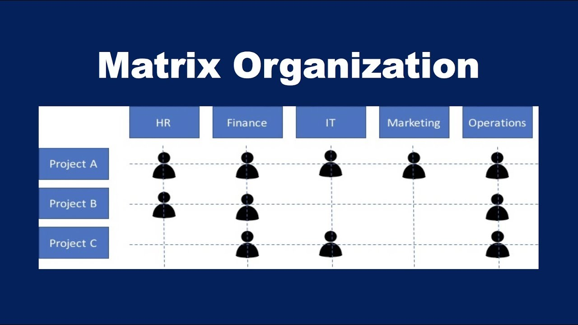
Matrix Structure-CONT…
In a matrix structure the team members are given more autonomy and expected to take on more responsibility for their work.
This increases the productivity of the team, fosters greater innovation and creativity, and allows managers to cooperatively solve decision-making problems through group interaction.
This type of organizational structure takes lots of planning and effort, making it appropriate for large companies that have the resources to devote to managing a complex business framework.

Slide 28

Functional Structure:
Under a functional organization structure, people who do similar tasks are grouped together based on specialty.
So, all the accountants are placed in the finance department and so on for the marketing, operations, senior management and human resources departments.
A functional org structure starts with positions with the highest levels of responsibility at the top and goes down from there.
Primarily, though, employees are organized according to their specific skills and their corresponding function in the company. Each separate department is managed independently.

Slide 29
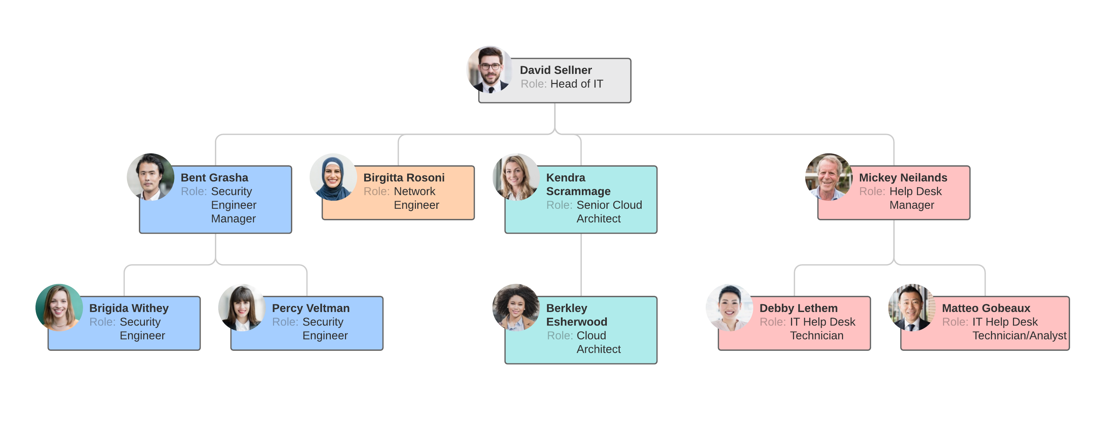
Functional org structure
The advantages of this kind of structure include quick decision making, because the group members can easily communicate. They can also learn from each other, since they already possess similar skill sets and interests.

Slide 30

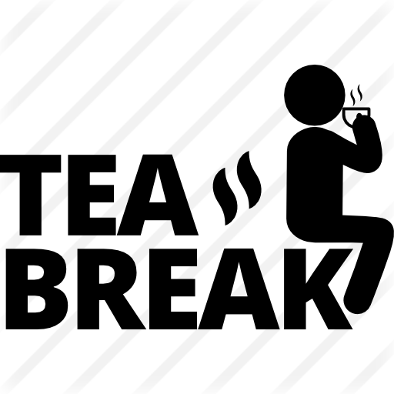
10 minutes break

Slide 31
Flatarchy, a newer structure, is the third type and is used among many startups.
As the name alludes, it flattens the hierarchy and chain of command and gives its employees a lot of autonomy.
A flat organizational structure attempts to disrupt the traditional top-down management system of most companies.
Management is decentralized so there is no everyday “boss.” Each employee is the boss of themselves, eliminating bureaucracy and red tape and improving direct communication.
some organizations maintain this structure since it encourages less supervision and more involvement from all employees.
Flat Organizational Structure

Slide 32
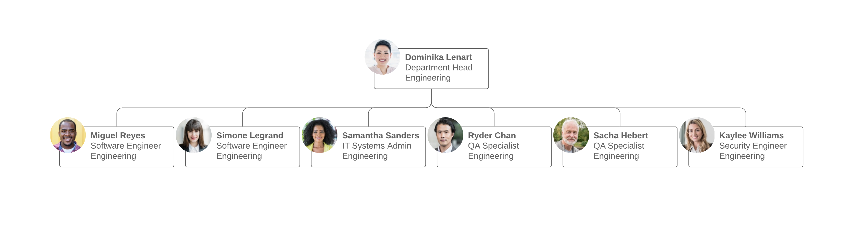
Horizontal or flat org structure
For example, an employee who has an idea doesn’t have to wade through three levels of upper managers to get the idea to the key person making the decision. The employee simply communicates directly with the target on a peer-based level.
A company adopting this type of structure for everyday purposes typically establishes a special top-down management system for temporary projects or events.

Slide 33
Hierarchical org structure.
The pyramid-shaped organizational chart we referred to earlier is known as a hierarchical org chart. It’s the most common type of organizational structure––the chain of command goes from the top (e.g., the CEO or manager) down (e.g., entry-level and low-level employees) and each employee has a supervisor.

Slide 34
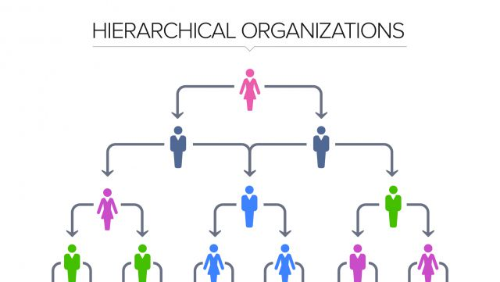
Hierarchical org structure.

Slide 35
Divisional org structure
In divisional organizational structures, a company’s divisions have control over their own resources, essentially operating like their own company within the larger organization.
Each division can have its own marketing team, sales team, IT team, etc.
This structure works well for large companies as it empowers the various divisions to make decisions without everyone having to report to just a few executives.

Slide 36
Depending on your organization’s focus, there’s a few variations to consider:
Market-based divisional org structure
Divisions are separated by market, industry, or customer type. A large consumer goods company, like Target or Walmart, might separate its durable goods (clothing, electronics, furniture, etc.) from its food or logistics divisions.
Product-based divisional org structure
Divisions are separated by product line. For example, a tech company might have a division dedicated to its cloud offerings, while the rest of the divisions focus on the different software offerings––e.g., Adobe and its creative suite of Illustrator, Photoshop, etc.
Geographic divisional org structure
Divisions are separated by region, territories, or districts, offering more effective localization and logistics. Companies might establish satellite offices across the country country or the globe in order to stay close to their customers.

Slide 37

Team-based org structure
It’ll come as no surprise that a team-based organizational structure groups employees according to (what else?) teams––think scrum teams or tiger teams.
A team organizational structure is meant to disrupt the traditional hierarchy, focusing more on problem solving, cooperation, and giving employees more control.

Slide 38
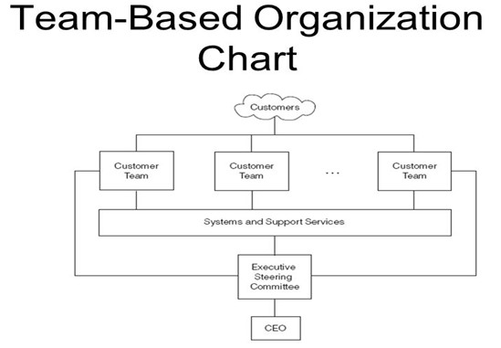

Slide 39
Network org structure
These days, few businesses have all their services under one roof, and juggling the multitudes of vendors, subcontractors, freelancers, offsite locations, and satellite offices can get confusing.
A network organizational structure makes sense of the spread of resources.
It can also describe an internal structure that focuses more on open communication and relationships rather than hierarchy.

Slide 40
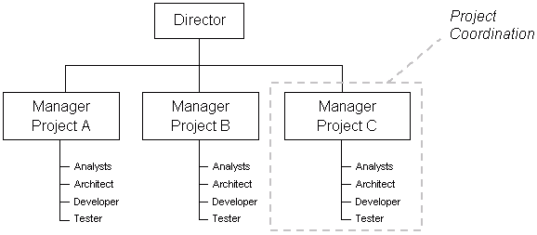
Project based organisation structure

Slide 41
How to create an organigram

Slide 42

Create an organization chart
https://support.microsoft.com/en-us/topic/create-an-organization-chart-9b51f667-11b7-4971-a757-a08a36684ee6

Slide 43
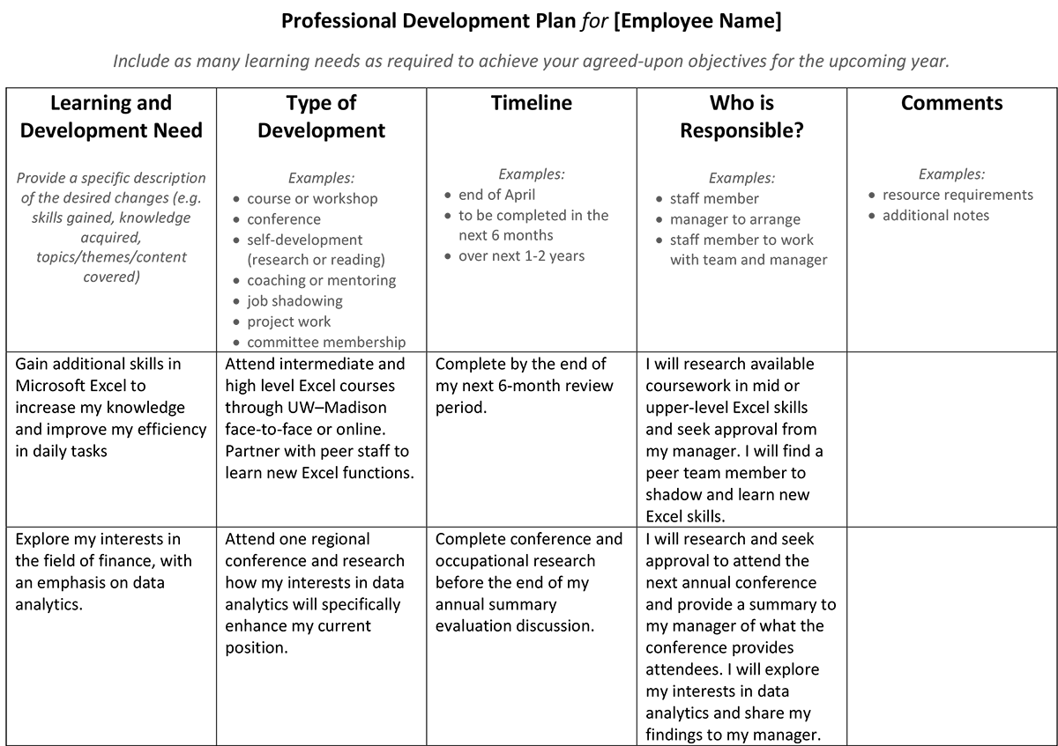
https://hr.wisc.edu/professional-development/develop-your-career/employee-development/career-goals/

Slide 44
Training and development plan
Objective What do I need to achieve | Action What do I have to do? | Resources Whose help and support do I need? | Criteria for success How would I measure the successful completion of this objective? | Target date When will I complete or review my progress?

Slide 45
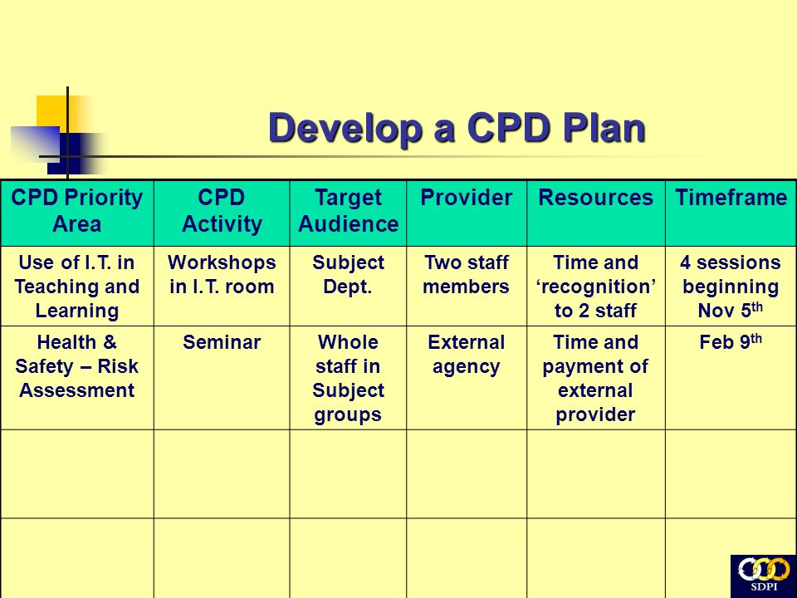
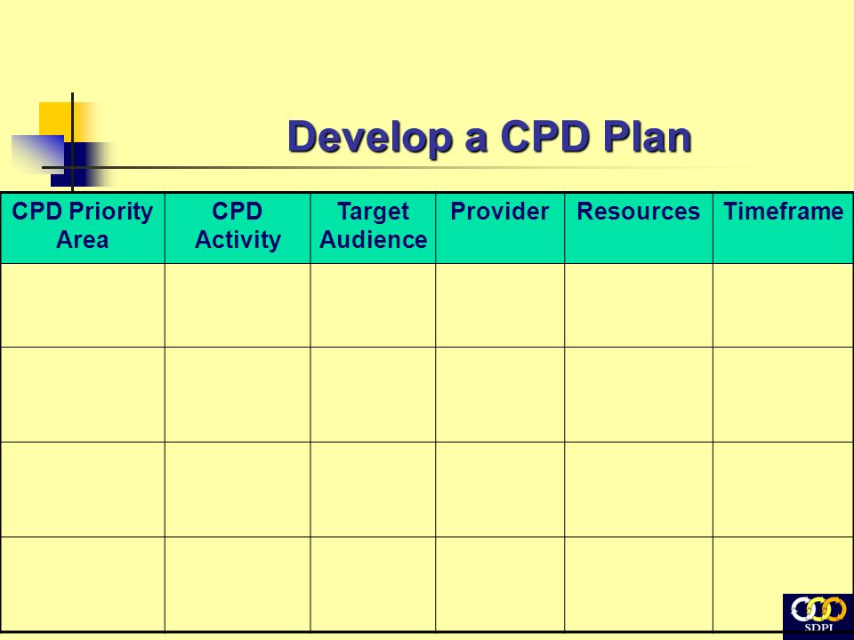

Slide 46
WRAP-UP
Question and Answer Session

Slide 47

End
This session has ended. Thank for your attendance and active participation. IT’S ALL ABOUT YOU !

Slide 49

Presenting your assignment
Title page-Your student number, the module and submission date
Content page
Introduction
Font –Ariel, Times New Roman
Font size -12
Line spacing – 1.5
Paragraphing-Not too short or too long
Page number
In text referencing using Harvard referencing style
Reference list using Harvard referencing style
Reference list should be in alphabetical order
Proof read for grammar errors
Submit as a single document i.e. a word document or Pdf
Conclusion

Slide 50
Reference list.
Lee, S.M., Luthans, F. and Olson, D.L., 1982. A management science approach to contingency models of organizational structure. Academy of Management Journal, 25(3), pp.553-566.
Child, J., 1972. Organizational structure, environment and performance: The role of strategic choice. sociology, 6(1), pp.1-22.
Hannan, M.T., Freeman, J.H. and Meyer, J.W., 1976. Specification of models for organizational effectiveness. American Sociological Review, 41(1), pp.136-143.
https://www.yourarticlelibrary.com/organization/organisation-meaning-concept-features-and-advantages/63768
https://www.nhsconfed.org/resources/key-statistics-on-the-nhs

